Slide 1
MARITIME
What does it mean?

Slide 2
Speaker 1
KHAIRUL ISLAM

Slide 3
MARITIME
What is Maritime?

Slide 4
MARITIME INDUSTRY
The Maritime Industry is waterborne commerce – it’s about moving people and goods over the water.
Maritime is most everything connected to the sea or waterways throughout the world, especially in relation to navigation, shipping, and marine engineering. The industry has a direct impact on much of our everyday lives.

Slide 5
Maritime Industry Segments
PORTS
SHIPPING
OFFSHORE WORKS
FISHING
SHIP BREAKING
SHIP BUILDING

Slide 6
WHY IS MARITIME INDUSTRY IMPORTANT
OVER 90% OF WORLD TRADE IS CARRIED BY SEA AND OCEAN
MOST COST EFFECTIVE AND EFFICIENT FOR MOVING LARGE VOLUMES OF GOODS
SUPPORTS MILLIONS OF JOBS
FISHING RESOURCES
TOURISM HOTSPOT

Slide 7
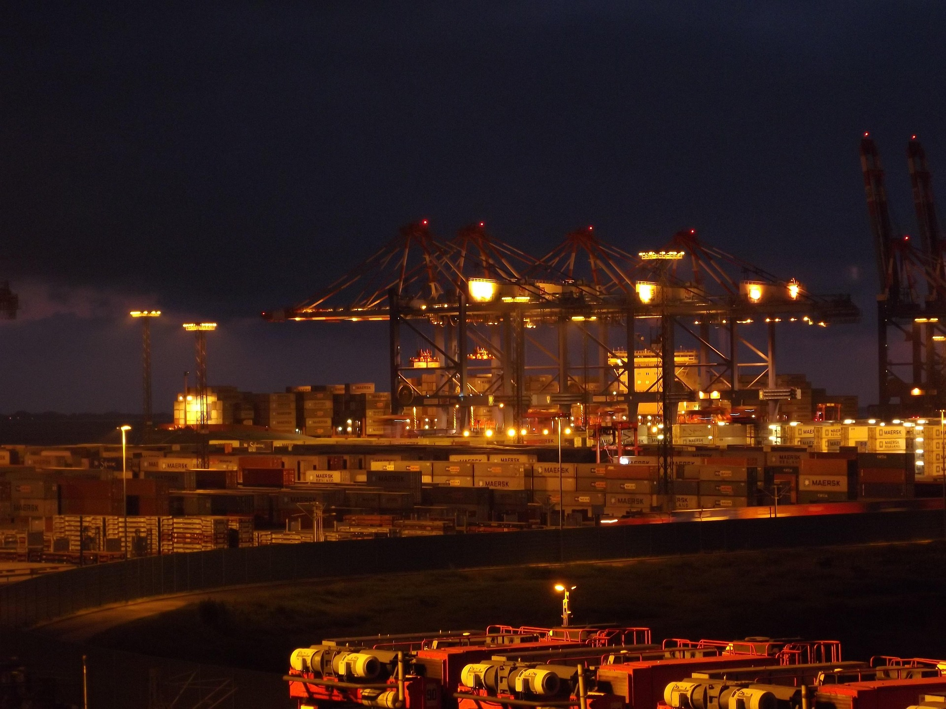
PORT
A Port is a geographical area where ships are brought alongside land to load and unload cargo – usually a sheltered deep water area such as a bay, or river mouth.

Slide 8
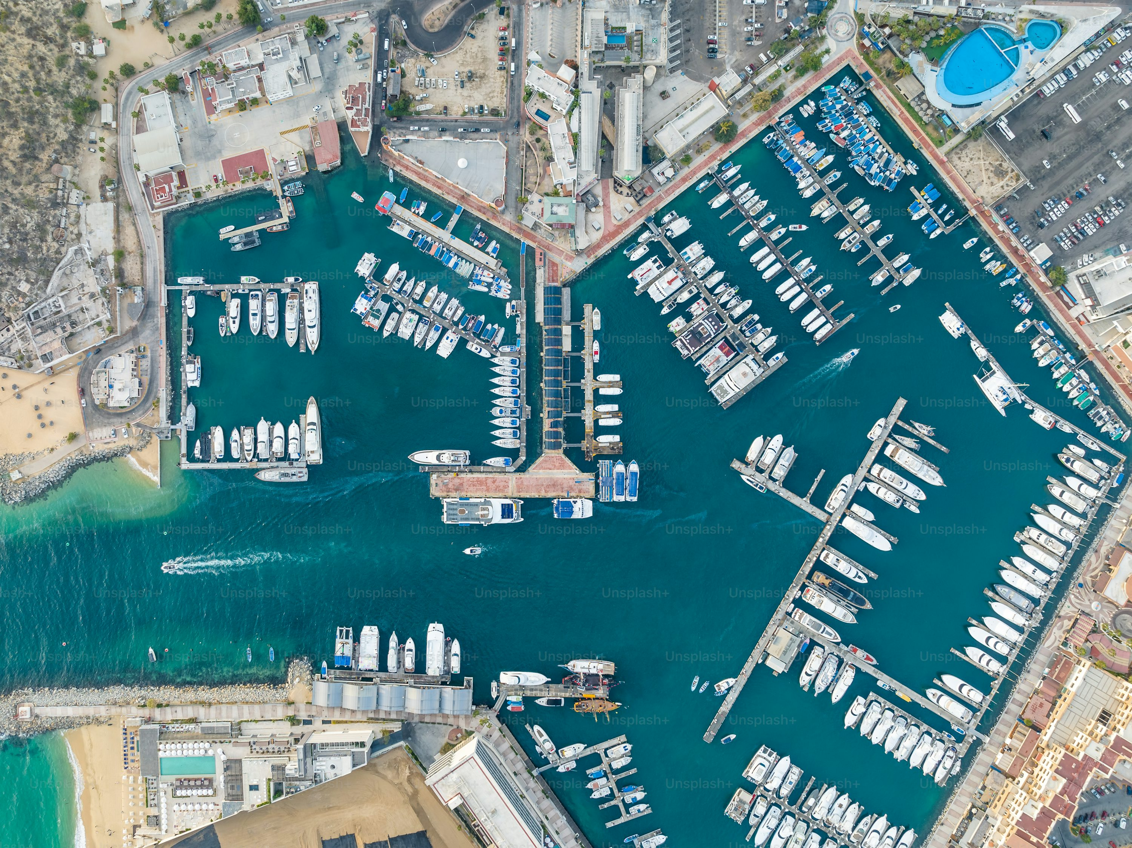
HARBOUR
A harbour can be a man made or a natural feature connecting a piece of land with a large water body that is mainly used to provide shelter to ships and vessels from bad weather. Harbours are used for safe anchorage of ships. Natural harbours are surrounded by land on most sides but have an entrance point to the sea. When harbours are artificially created, they serve as ports.

Slide 9
PORT VS HARBOUR
ASPECT | PORT | HARBOUR
NATURE | Man-made | Natural or Artificial
PURPOSE | Trade, commerce | Safe anchorage, protection from rough seas
ACTIVITY | Loading/Unloading, Customs clearance, Shipping | Anchoring, Waiting, Protection from weather
COMPONENTS | Docks, Cranes, Warehouse, Terminal | Break waters, Jetties, Piers

Slide 10
IDEAL PORT OR HARBOUR
Deep and Calm Water
Minimum Interference
Strategic Location
Multi-Modal Connectivity
Expandability
Sustainability

Slide 11
CLASSIFICATION
CONDITION
Natural or Man Made
Tidal or Non Tidal
FUNCTION
Commercial Port
Refuge Harbour
FACILITY DEV
Small Local Port
Large Local Port
Sea or River Port
Sandy or Rocky or Muddy Port
Industrial Port
Fishing Port
Recreational Port
Military Port
Large Regional Port
Large Distribution Center

Slide 12
CLASSIFICATION
TRADE PATTERN
Foreign Trade Port
Domestic Trade Port
CALLING PATERN
Hub Port
Free Port
Feeder Port

Slide 13
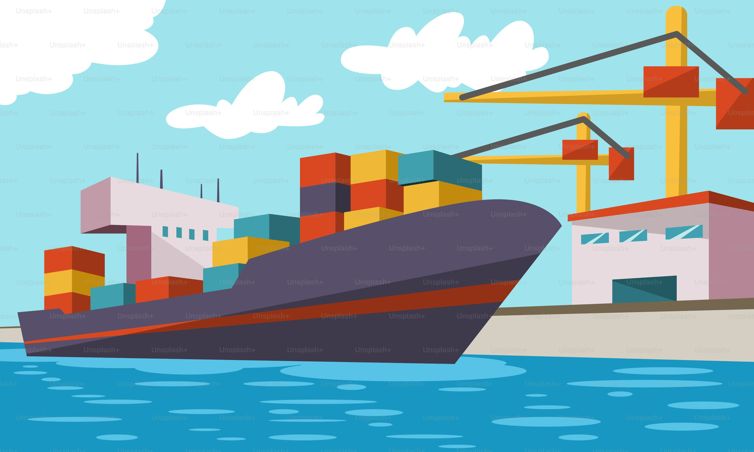
PORT INFRASTRUCTURES
Entrance Channel
Breakwater
Sea Locks
Turning Basin
Shelter Basin
Peer, Wharf, Jetty, Quay
IWT

Slide 14
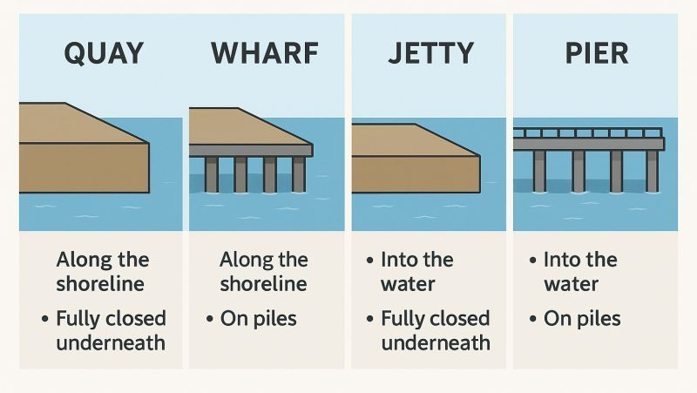
WHARF QUAY PIER JETTY
PILE
FILL
WHARF
QUAY
PARALLEL
PIER
JETTY
EXTEND

Slide 15
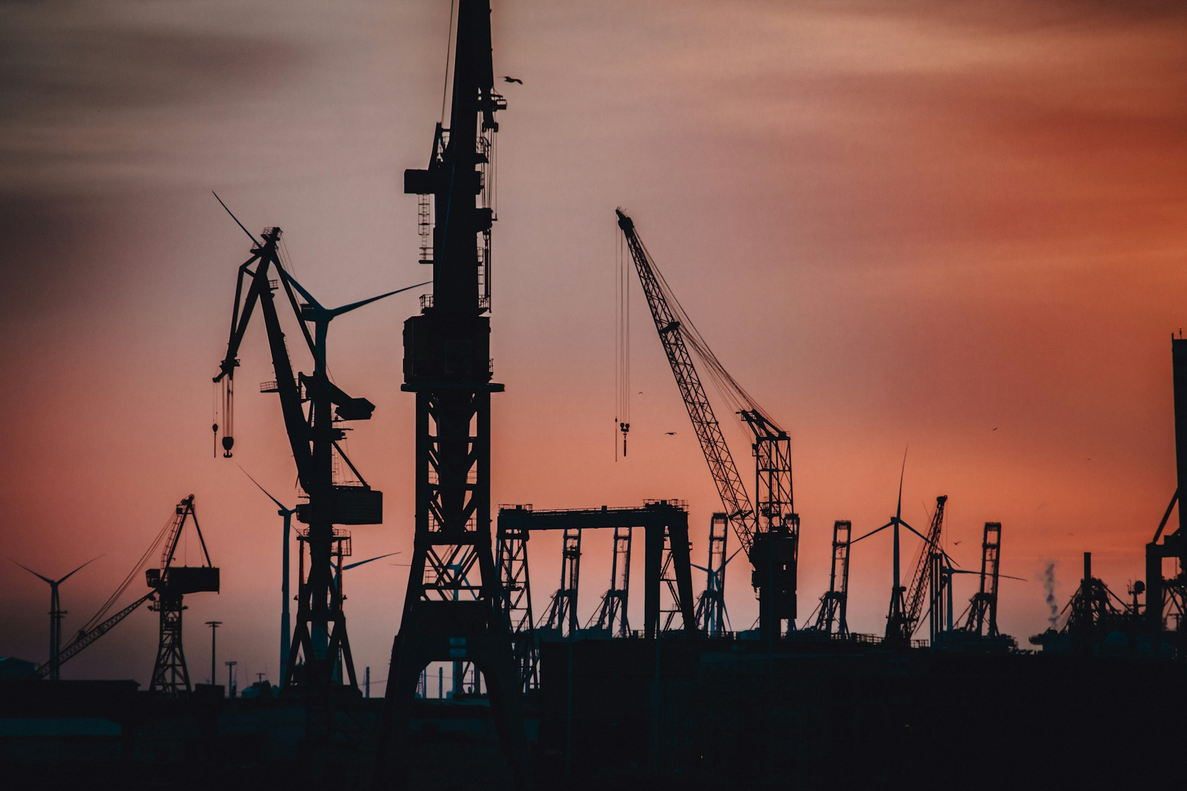
Port superstructure
Paving and surfacing;
Terminal lighting;
Parking areas;
Sheds, warehouses, and stacking areas;

Slide 16
Port equipment
Tugs
Line handling vessels
Dredging equipments
Ship and shore handling equipments
Cargo handling equipments

Slide 17
Port function
Functions of a port can be divided into two main parts.
Navigational Service
Handling Service
Service for Ships
Service for Cargo

Slide 18
Services and Facilities for Ships
Berthing
Navigation aids
VTS
Approach channel, breakwater
Pilotage, tugs and mooring gangs
Berths, turning basins, locks(if tidal)
Repairing

Slide 19
Services and Facilities for Cargoes
Ship
Cargo handling
Transfer
transport to/from storage
Storage
storage at shed, silo, open space
Gate
tallying, marking, weighing, surveying
surveillance, protection, sanitary measures
dangerous cargo segregation
customs and documentary control
receiving and delivery

Slide 20
PORT’S ROLE
Landlord for private entities offering a variety of services;
Regulator of economic activity and operations;
Regulator of marine safety, security, and environmental control;
Planning for future operations and capital investments;
Marketer and promoter of port services and economic development;
Provider of ancillary activities (police, immigration, health, supply of fresh water, fuel, food, telephone, medical, waste disposal etc.

Slide 21

PORT’S ROLE
Additional value added services
repackaging, labeling, sorting, assembling
cleaning and preparing cargo
setting up a logistic network
setting up a marketing package

Slide 22

IMPORTANCE OF PORT
Port is a location
Where most maritime accidents happens;
Where cargo is damaged or stolen;
Where repairs are carried out;
Where most cost are incurred;
Where delays are most likely to occur;
Where most shipping services are located, e.g. agents, brokers, etc.
Where industries are situated;
Where cargoes come from;

Slide 23
IMPORTANCE OF PORT
Distribution centre;
Industrial zone and energy supply base;
Mercantile trading centre-attracting banks, brokers and traders;
Urbanization and city redevelopment centre;
Life activity base-this is particularly the case for the smaller rural ports;
Maritime leisure base-yacht marinas, dockside recreation facilities, cruise ship terminal.

Slide 24
Speaker 4
TAHSIN HASIB

Slide 25

PORT DEVELOPMENT
There is no clear pattern of port development as the development have influenced with a combination of:
Trade, economic, spatial, political, social, and even cultural and military influence;
Labor-intensive merchant port to capital and technology –intensive enterprise;
Driving factors of port development are considered:
Industrial revolution;
Containerization.

Slide 26
Global operators
Container
MSC
CMA CGM
Bulk
Teeky
Euronav
Cruise
Carnival Corporation
Norwegian Cruise Line
Offshore
Terminal
DP World
PSA International
APM Terminal
Hutchison Port
Bourbon Offshore
DOF Group
Maersk Supply Service
Royal Caribbean Group
Frontline
Maersk
COSCO

Slide 27
Speaker 4
MD ISMAIL HOSSAIN

Slide 28
PORT MODEL
1
Service Port
Tool Port
Landlord Port
Private Port
2
3
4

Slide 29
SERVICE PORT
Description: The port authority owns, operates, and manages everything—infrastructure, superstructure, and port services.
Public Role: Full control by the public sector (government or port authority)/but can be operate by private entity.
Private Role: Minimal to none.
Examples: Some ports in developing countries; traditionally used in centrally planned economies.
Pros: Centralized control, easy coordination
Cons: Inefficiencies, bureaucratic delays, limited innovation

Slide 30
Tool PORT
Description: The port authority owns and maintains the infrastructure and equipment, but private companies operate the services (like cargo handling).
Public Role: Owns port land and equipment.
Private Role: Operates terminals and services using public equipment.
Examples: Some Indian and African ports.
Pros: Shared responsibility, early form of public-private cooperation
Cons: Conflicts over equipment use, inefficiencies in service delivery

Slide 31
landlord PORT
Description: The port authority owns the land and basic infrastructure, but leases terminals to private operators who invest in and operate the superstructure (cranes, warehouses, etc.).
Public Role: Regulator, landlord, strategic planner.
Private Role: Terminal operations, investments, employment.
Examples: Rotterdam, Singapore, Antwerp, Hamburg, Port of Los Angeles.
Pros: Encourages private investment, efficient operations
Cons: Regulatory challenges, risks of monopolistic behavior

Slide 32
PRIVATE PORT
Description: Private companies own and operate most of the port, including land and infrastructure.
Public Role: Limited to regulatory oversight.
Private Role: Full operational and investment control.
Examples: Some UK ports (e.g., Felixstowe), parts of the U.S. under public-private partnerships.
Pros: High efficiency, commercial flexibility
Cons: Risk of under-regulation, focus on profit over public interest

Slide 33
COMPARISON
Type | Infrastructure | Superstructure | Port Labor | Other Functions
Service | Public | Public | Public | Majority Public
Tool | Public | Public | Private | Public/Private
Landlord | Public | Private | Private | Public/Private
Private | Private | Private | Private | Majority Private

Slide 34
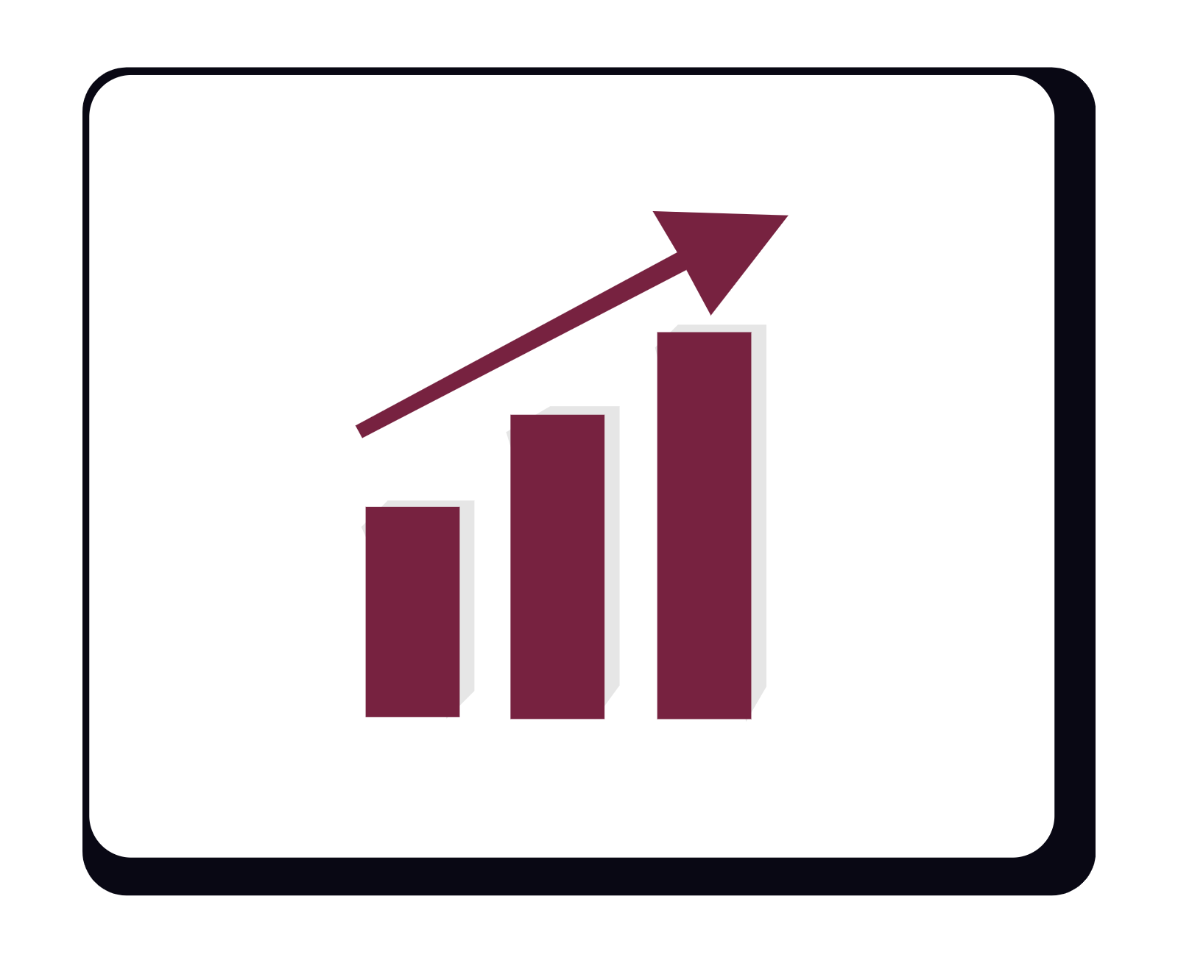
CURRENT AND FUTURE TREND
In the present context port management is experiencing change along four dimensions:
Extension of the port role
Strategies of vertical and horizontal integration
Redefinition of port foreland and hinterland
Reassessment of the port customer

Slide 35
CURRENT CHALLENGES
Larger Vessels and Cargo Concentration
ports need larger cranes, traditionally designed crane able to serve 13 containers wide vessels
post panamax vessels are having a 18 containers wide
Latest generation of vessels even needs more greater reach up to 22 to 23 containers
Environmental Concern

Slide 36
Types of Pollution Occurring in PORT
Emission
Cars
Ships
Cargo Operations
Light
Noise
Accident
Oil Spill
Cargo Spill
Trucks
Railway
Cranes
Dust
Vibration
Wash Off
Ballast Water

Slide 38
LOgistics

Slide 39
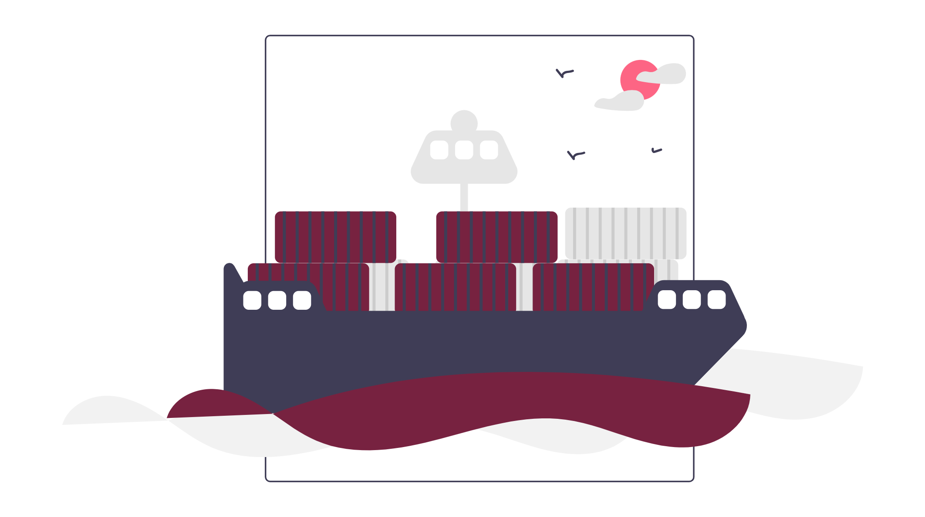
logistics
What is Logistics

Slide 40

INBOUND LOGISTICS
It's all about the movement of raw materials to production.
Inbound logistics includes:
Raw material sourcing
Inventory management
Warehousing
Transportation
Production

Slide 41

OUTBOUND LOGISTICS
It’s all about transporting the finished goods to the customer or end user.
Outbound logistics includes:
Order fulfilment
Packing
Shipping
Delivery
Customer service

Slide 42
Speaker 7
JAHIN ABRAR

Slide 43

LOGISTIC SERVICE PROVIDER
What is Logistic Service Provider?

Slide 44
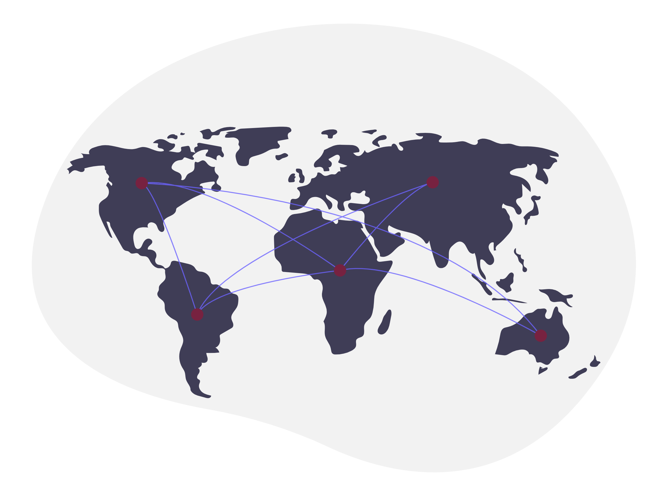
Logistic service provider
The five “R”s of logistics
Right Goods
Right Place
Right Time
Right Form
Right Price

Slide 45
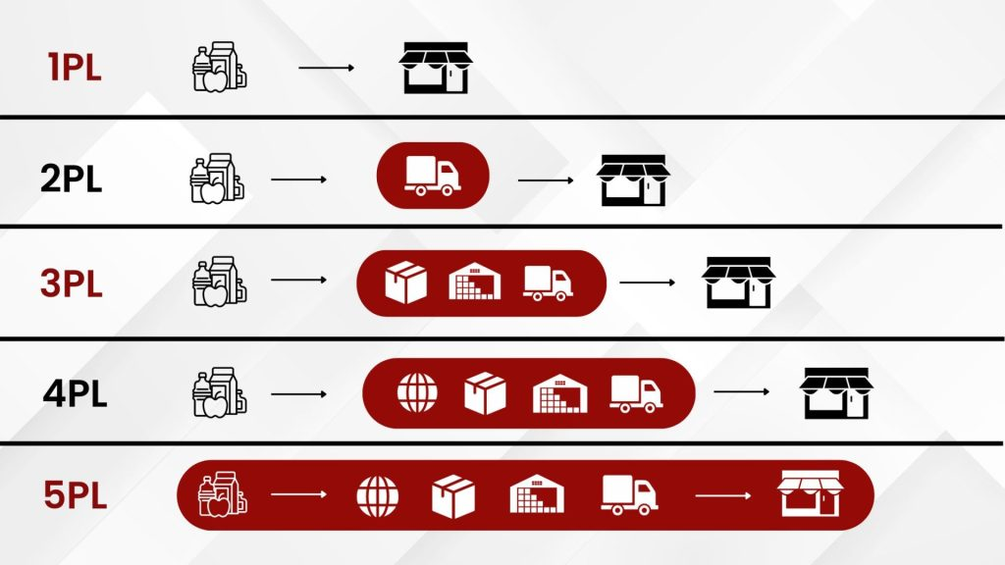
Logistic service provider
Types of logistic service providers

Slide 46

LOGISTIC SERVICE PROVIDER
Types of LSPs in real life
Couriers
Integrators
Agencies
Freight Forwarders
NVOCCs

Slide 47
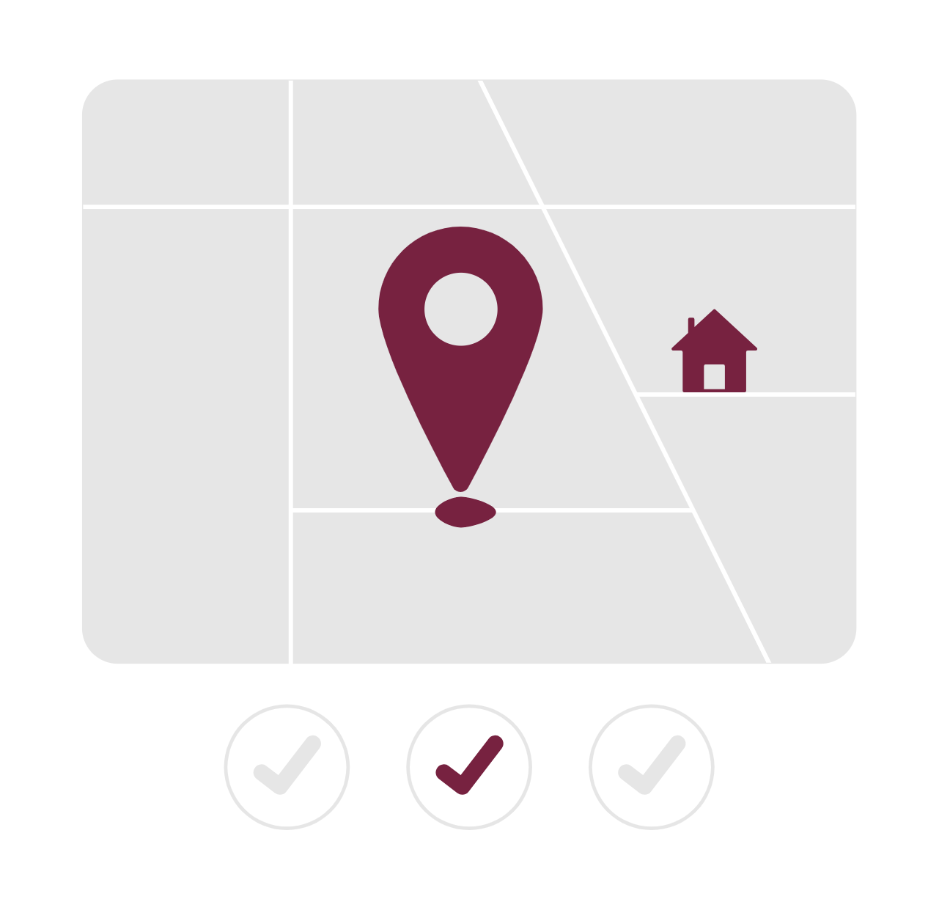
LOGISTIC SERVICE PROVIDER
Why LSPs are important?

